Slide 1

KLMUG13
-- MongoDB Day KL :: 2013 --
Website: http://nosqlasia.org
FB: http://facebook.com/groups/klmug
Twitter Handle: @klmug
--------------------------------------------------
GitHub: github.com/r1dotmy/klmugs
Notes:
1

Slide 2



MongoDB Day KL :: Sponsors
http://10gen.com
http://nook.my
http://are-one.com
Notes:
2

Slide 3

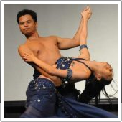
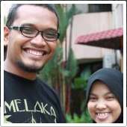
Malaysian MongoStars - 2013
Affandy
@rossaffandy
Tristan
@parasquid
Akmal
@akmalfikri
Notes:
3

Slide 4
The State of MongoDB in Malaysia
13 Meet-Ups over 18 Months
Government Presentations, Astro TV Featurette
2nd Largest MongoDB Community in South East Asia
-------------------------------------------------
Introducing MongoDB in Malay
http://www.slideshare.net/ayohmang/presentation-mongodb-public-sector-dbsig-malaysia
Notes:
4

Slide 5
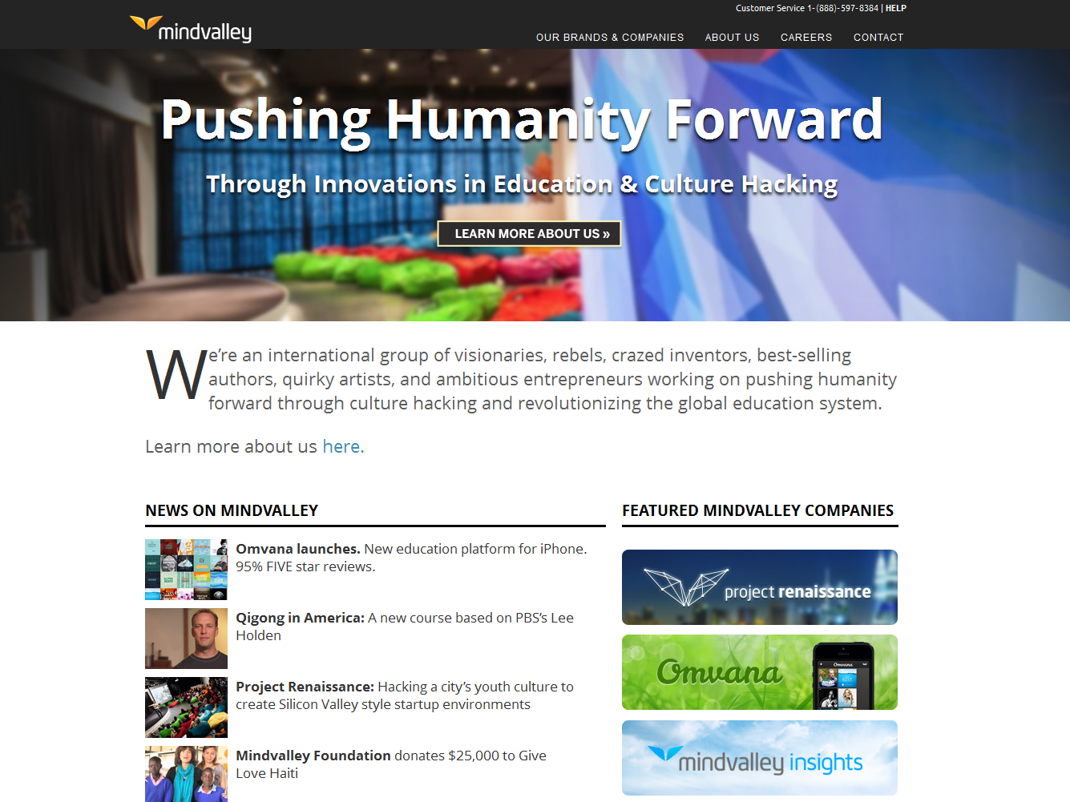
Mindvalley - http://mindvalley.com
Notes:
5

Slide 6
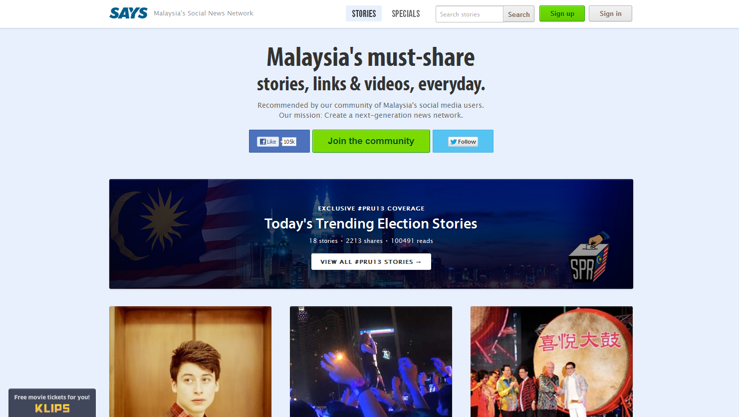
SAYS - http://says.com
Notes:
6

Slide 7
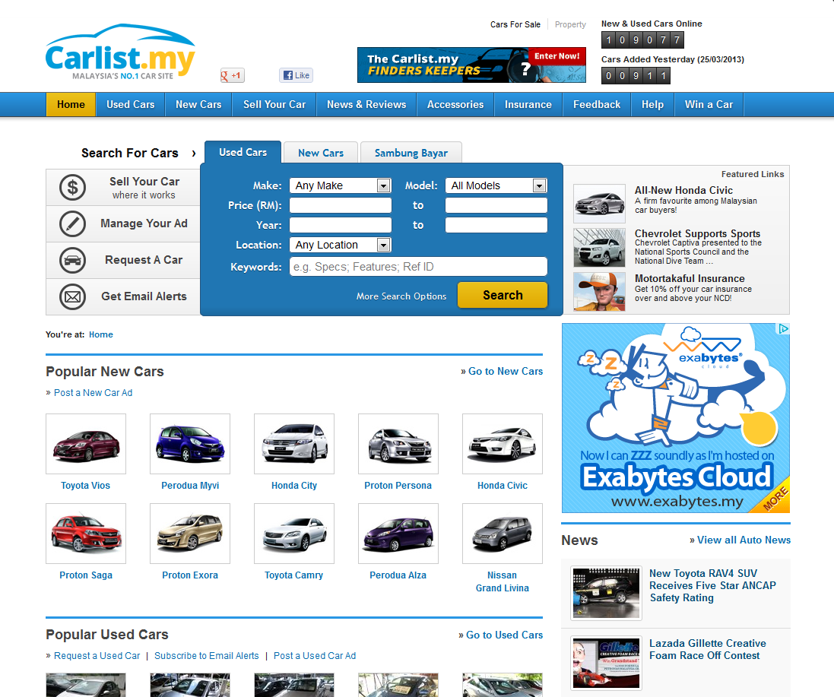
Car List - http:/carlist.my
Notes:
7

Slide 8
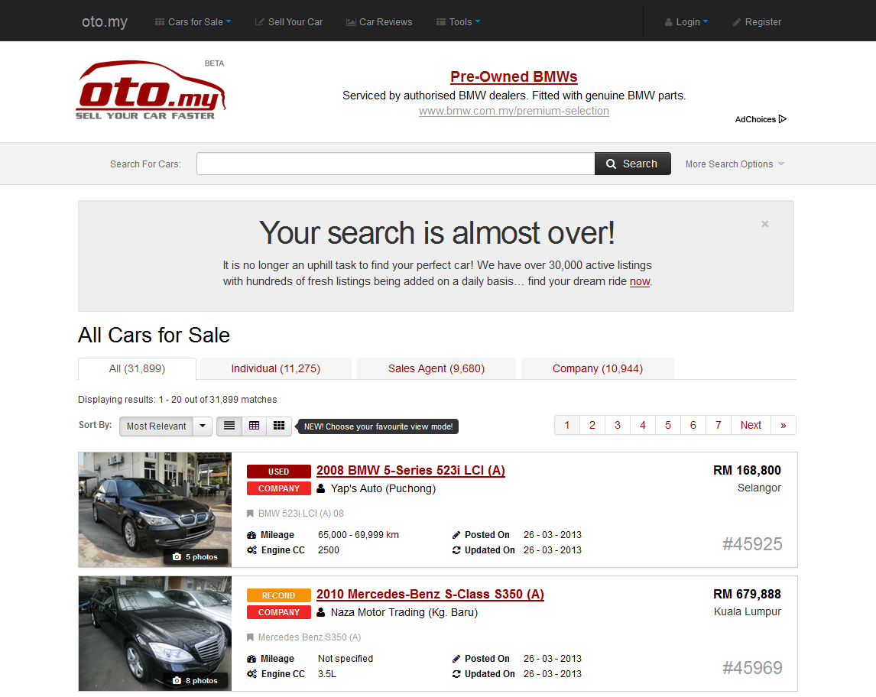
OTO - http://oto.my
Notes:
8

Slide 9
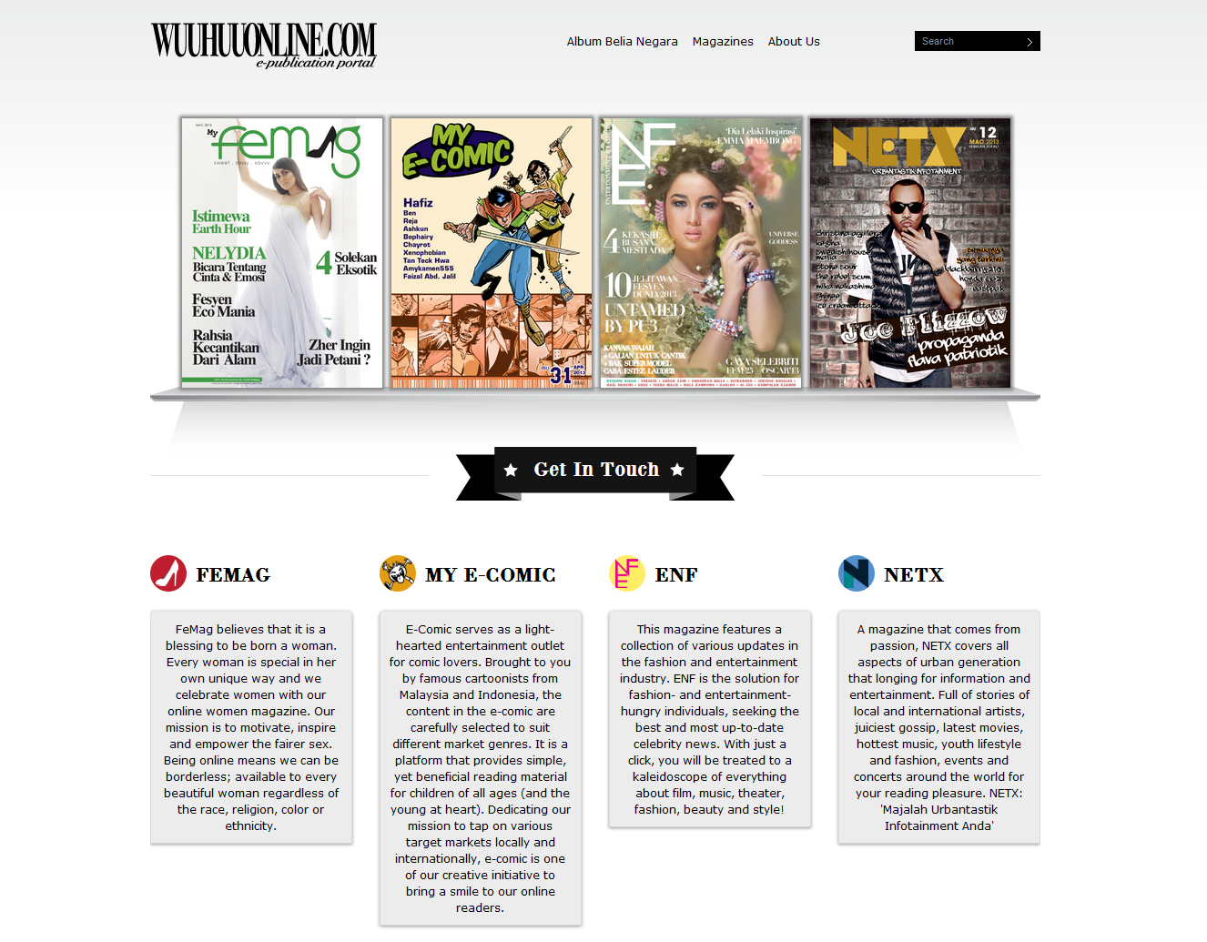
WuuHuuOnline - http://wuuhuuonline.com
Notes:
9

Slide 10
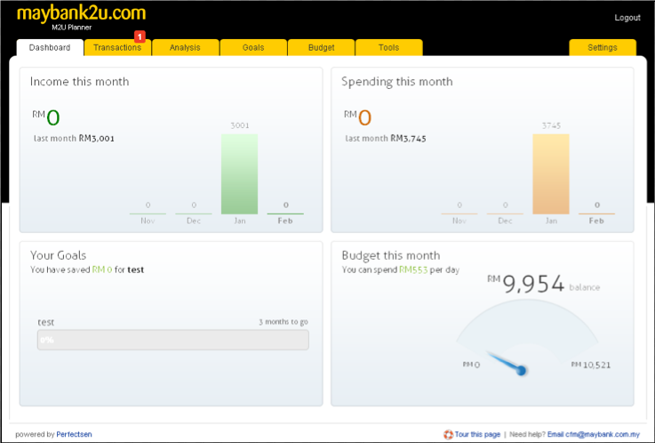
Maybank - http://maybank2u.com
Notes:
10

Slide 11
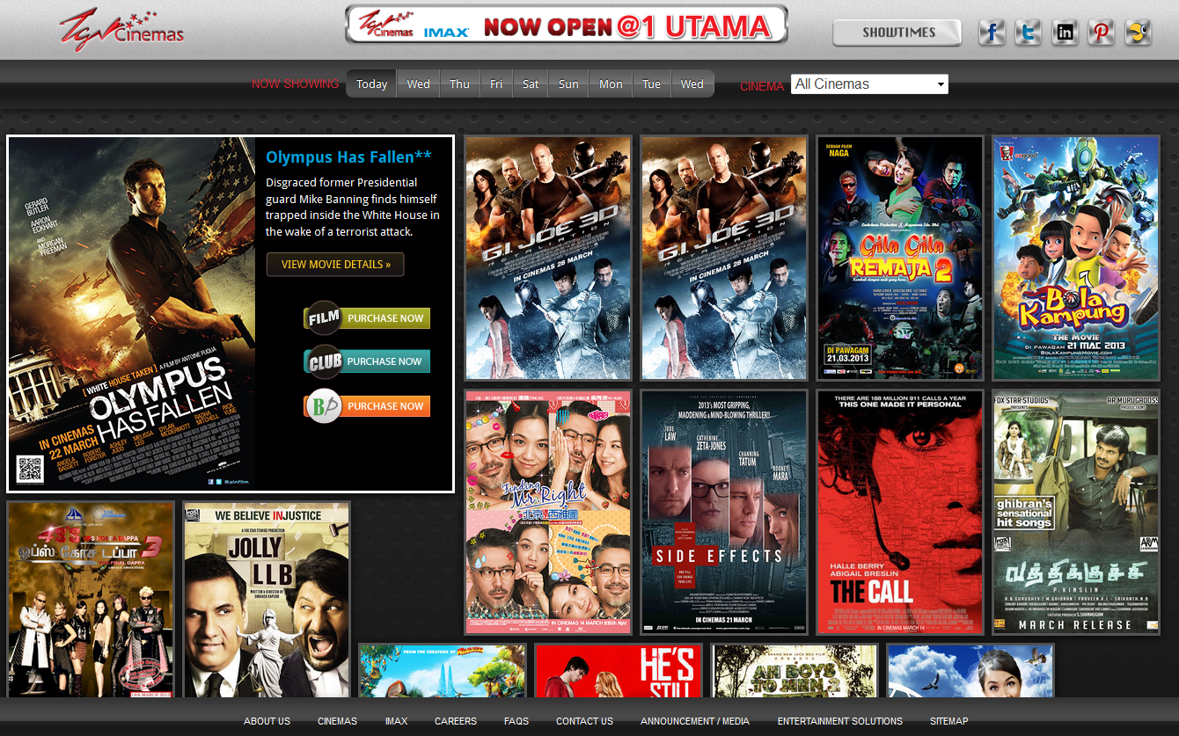
TGV Cinemas - http://tgv.com.my
Notes:
11

Slide 12
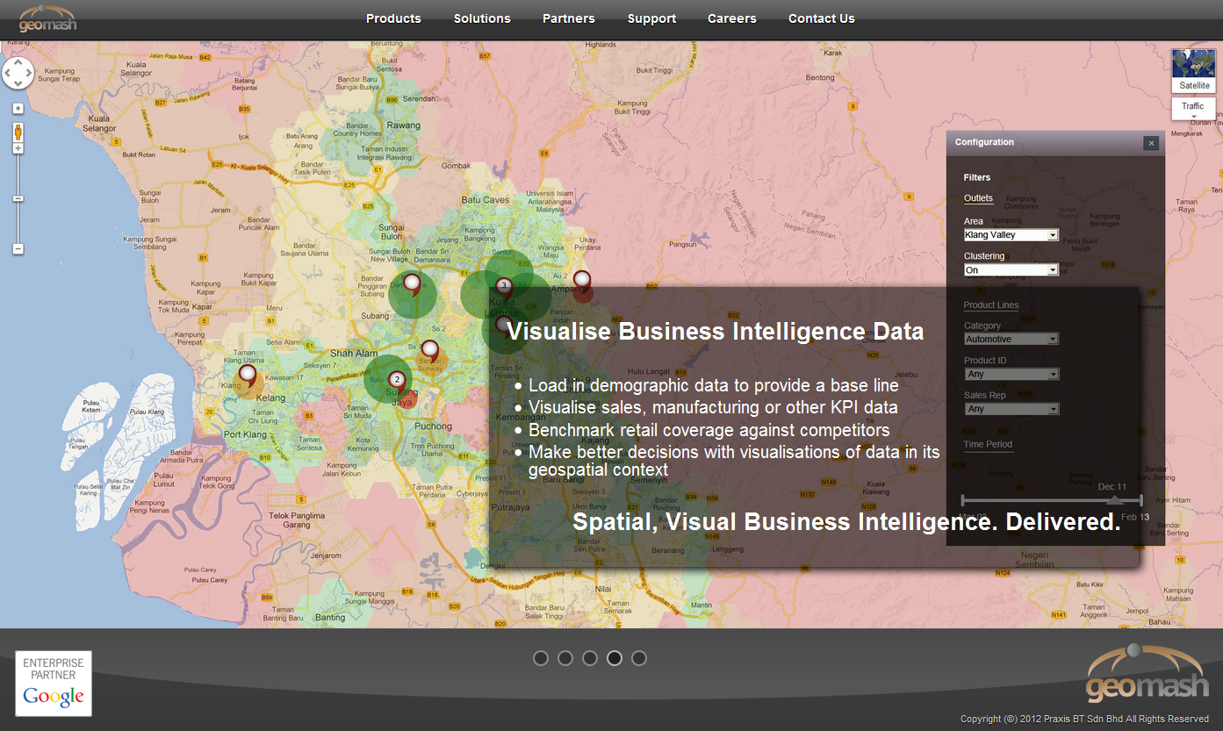
TGV Cinemas - http://tgv.com.my
Notes:
12

Slide 13
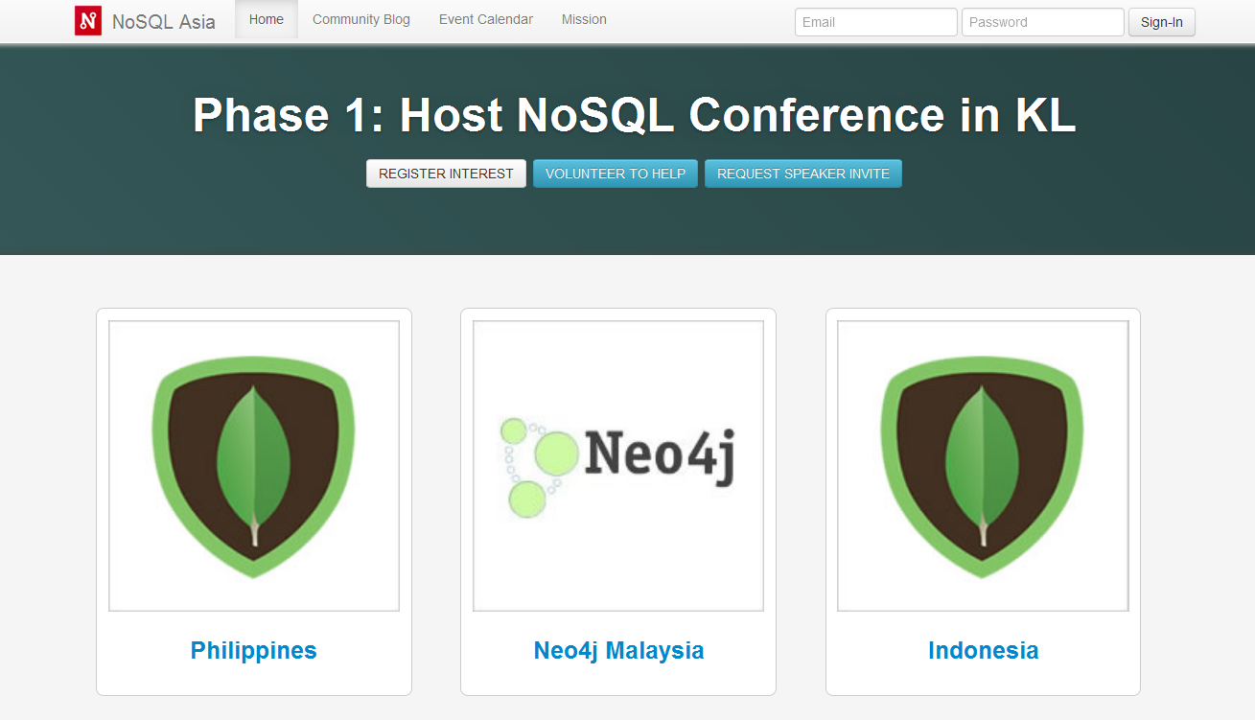
NoSQL Asia - http://nosqlasia.org
Notes:
13

Slide 14
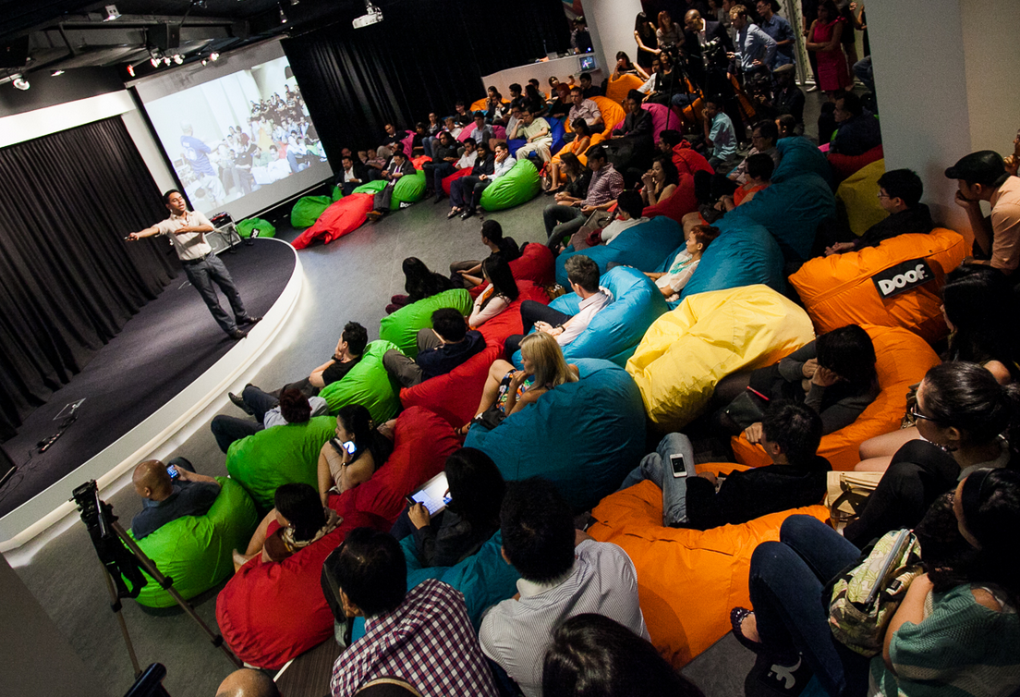
KL MUG Hosts :: Project Renaissance
Notes:
14

Slide 15
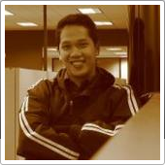
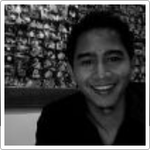
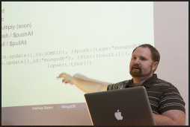
The Main Event
MongoDB and Says.com
With Arzumy & Nguyen - @arzumy
FTS & Aggregation
With Mathias Stearn @mathias_mongo
Notes:
15

Slide 16
BUT FIRST
( as promised )
My Brief Introduction to MongoDB
Notes:
16

Slide 17

GREAT GEO-LOCATION SUPPORT
Notes:
17

Slide 18
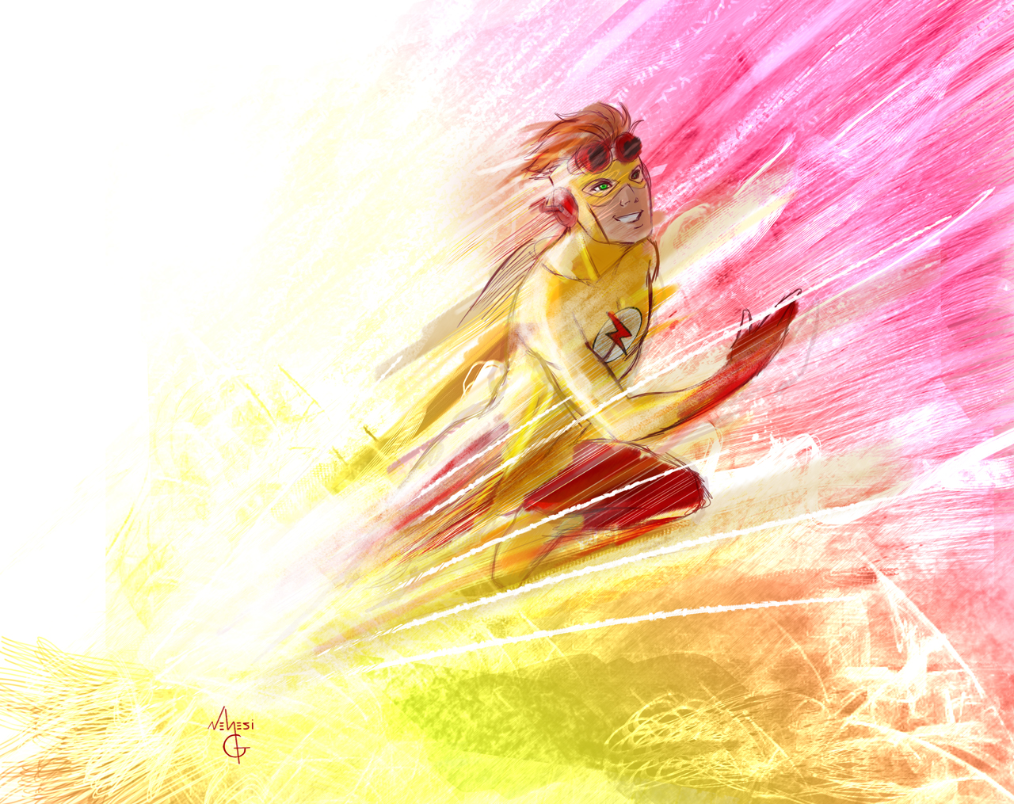
IT’S VERY FAST
Notes:
18

Slide 19
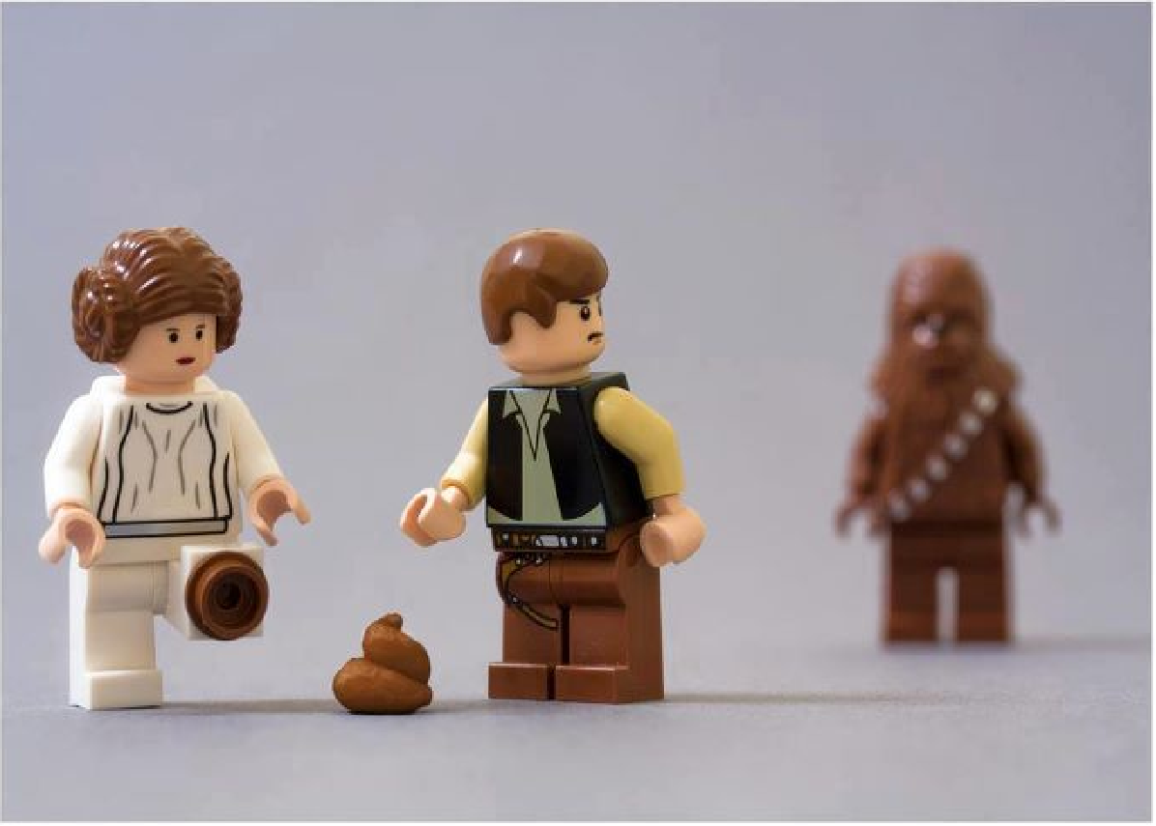
NO LANGUAGE BARRIERS
Notes:
19

Slide 20
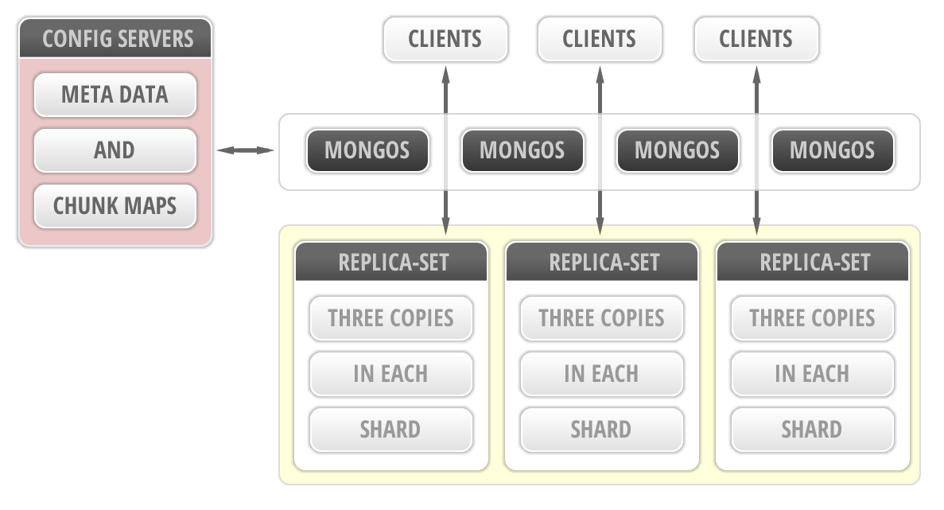
REPLICATED AND LOAD-BALANCED
Notes:
20

Slide 21

SCHEMALESS - AND BSON
Notes:
21

Slide 22

THERE IS NO SPOON
Notes:
22

Slide 23
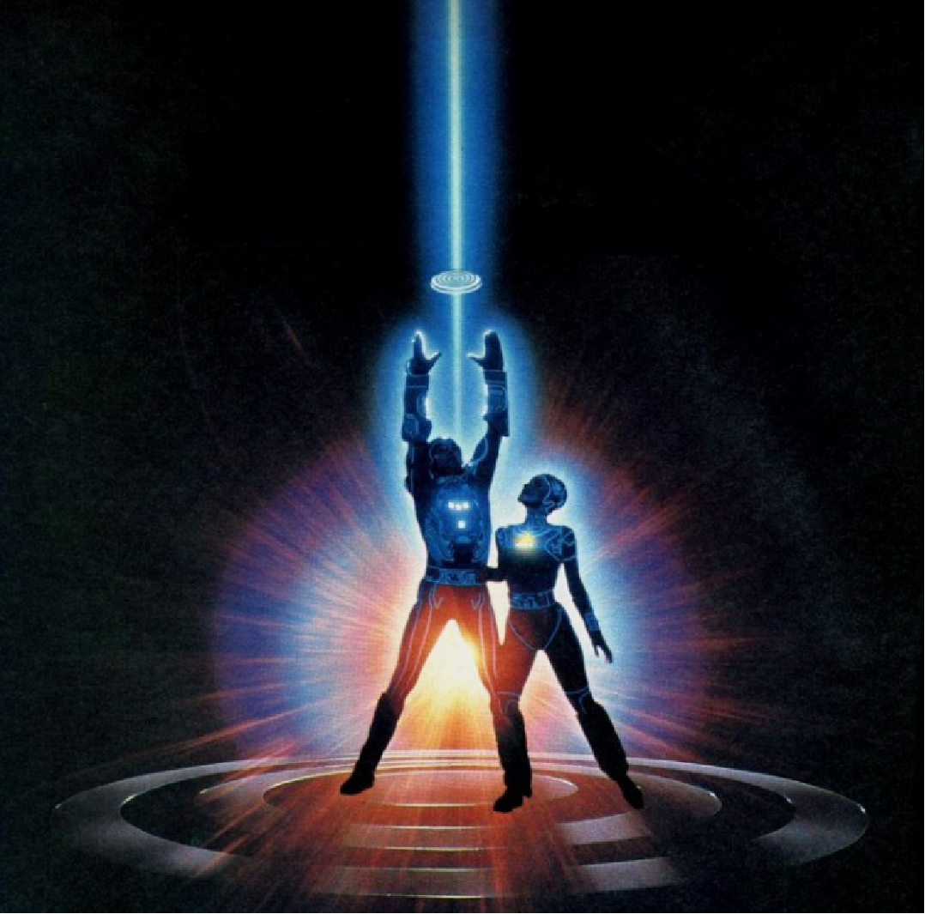
STORE & SERVE MEDIA WITH GRIDFS
Notes:
23

Slide 24
KLMUG13
-- MongoDB Day KL :: 2013 --
Website: http://nosqlasia.org
FB: http://facebook.com/groups/klmug
Twitter Handle: @klmug
--------------------------------------------------
GitHub: github.com/r1dotmy/klmugs
Notes:
24

